Slide 1
http://www.vidyanidhi.com/
ketkiacharya.net@gmail.com
Ketki Acharya
From: SM VITA ATC of CDAC
ketkiacharya.net@gmail.com

Slide 2
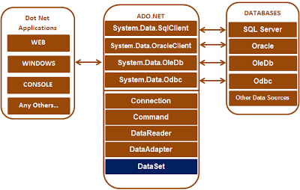

Slide 3
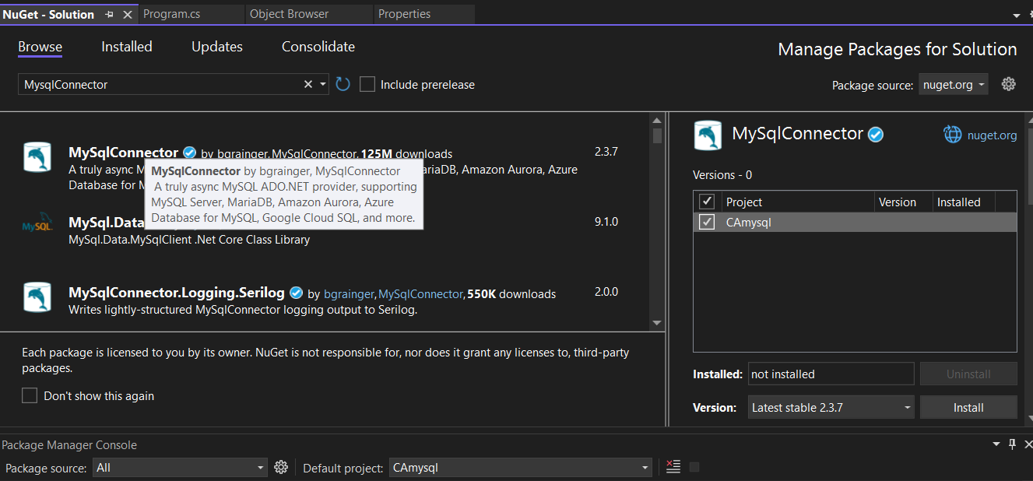
{
"ConnectionStrings": {
"Default": "Server=localhost;User ID=root;Password=root;Database=mydb"
}
}

Slide 4
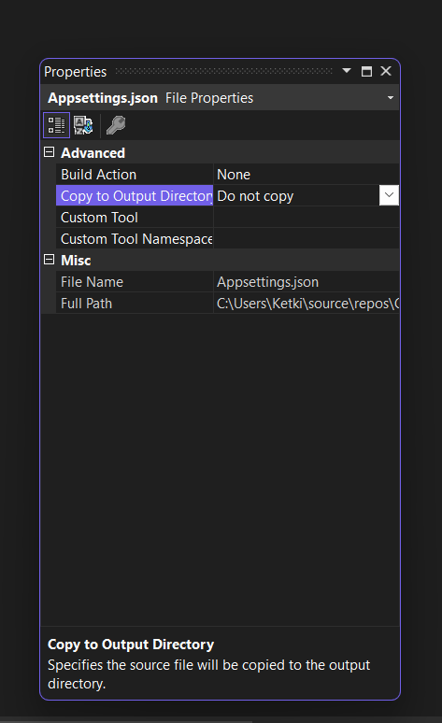

Slide 5
using Microsoft.Extensions.Configuration;
using MySqlConnector;
namespace CAmysql
{
public class Productlayer
{
private string _connectionString;
public Productlayer(IConfiguration iconfiguration)
{
_connectionString = iconfiguration.GetConnectionString("Default");
}
public void Products()
{
using (MySqlConnection con = new MySqlConnection(_connectionString))
{
// Pass the connection to the command object, so the command object knows on which
// connection to execute the command
MySqlCommand cmd = new MySqlCommand("Select * from Product", con);
// Open the connection. Otherwise you get a runtime error. An open connection is
// required to execute the command
con.Open();
Console.WriteLine("connected");
MySqlDataReader rdr = cmd.ExecuteReader(); //returns object of sqldatareder
if (rdr.HasRows)
{
while (rdr.Read())
{
Console.WriteLine("{0} {1} {2} {3}", rdr["Id"], rdr["Name"], rdr["Price"], rdr["Qty"]);
}
}
}
}
} }

Slide 6
internal class Program
{
private static IConfiguration _iconfiguration;
static void Main(string[] args)
{
GetAppSettingsFile();
Printproduct();
}
static void GetAppSettingsFile()
{ var builder = new ConfigurationBuilder()
.SetBasePath(Directory.GetCurrentDirectory())
.AddJsonFile("appsettings.json", optional: false, reloadOnChange: true);
_iconfiguration = builder.Build();
}
static void Printproduct()
{ Productlayer obj = new Productlayer(_iconfiguration);
obj.Products();
}
}

